Slide 1
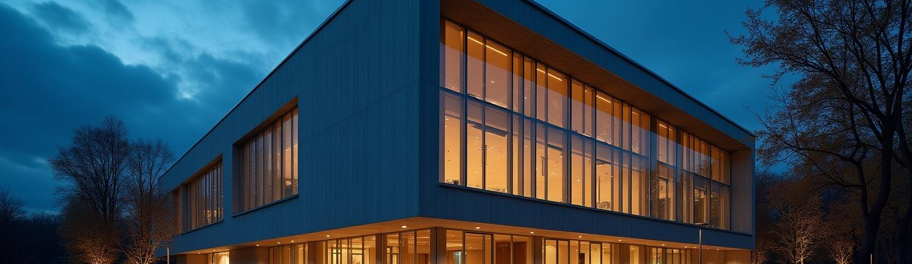
Lighting in Buildings
Month
00th
K.VARSHITHA DS-A (23R11A6719)

Slide 2
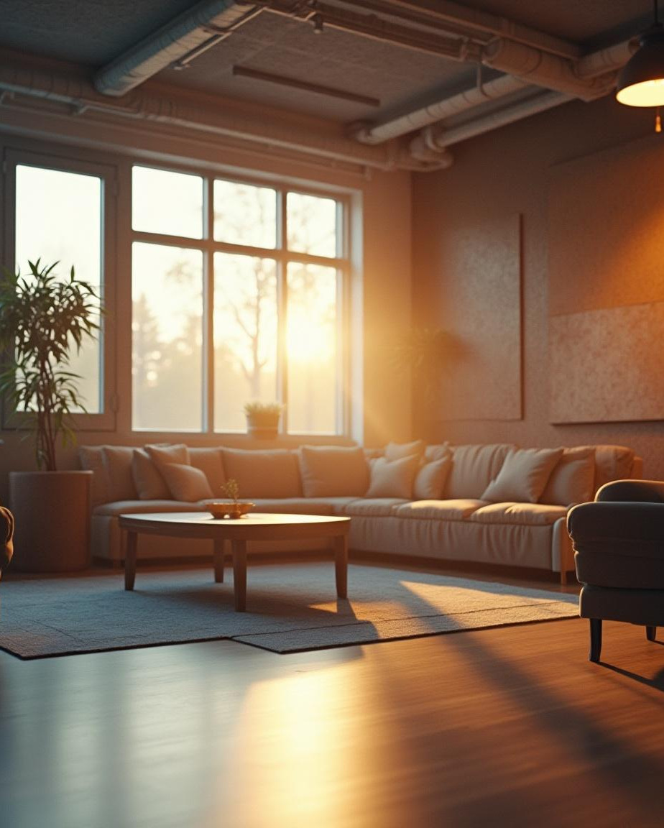
Introduction
Lighting plays a crucial role in building design and functionality. It not only illuminates spaces but also affects the mood, comfort, safety, and aesthetics of the occupants. Proper lighting enhances visibility, supports the activities carried out within the space, and contributes to the overall architectural appeal.
In modern buildings, lighting systems are carefully planned by considering natural daylight, energy efficiency, and the specific needs of each area. The design involves the use of different types of lighting such as ambient, task, accent, and decorative lighting. The integration of smart lighting technologies also helps in reducing energy consumption and improving user experience.

Slide 3
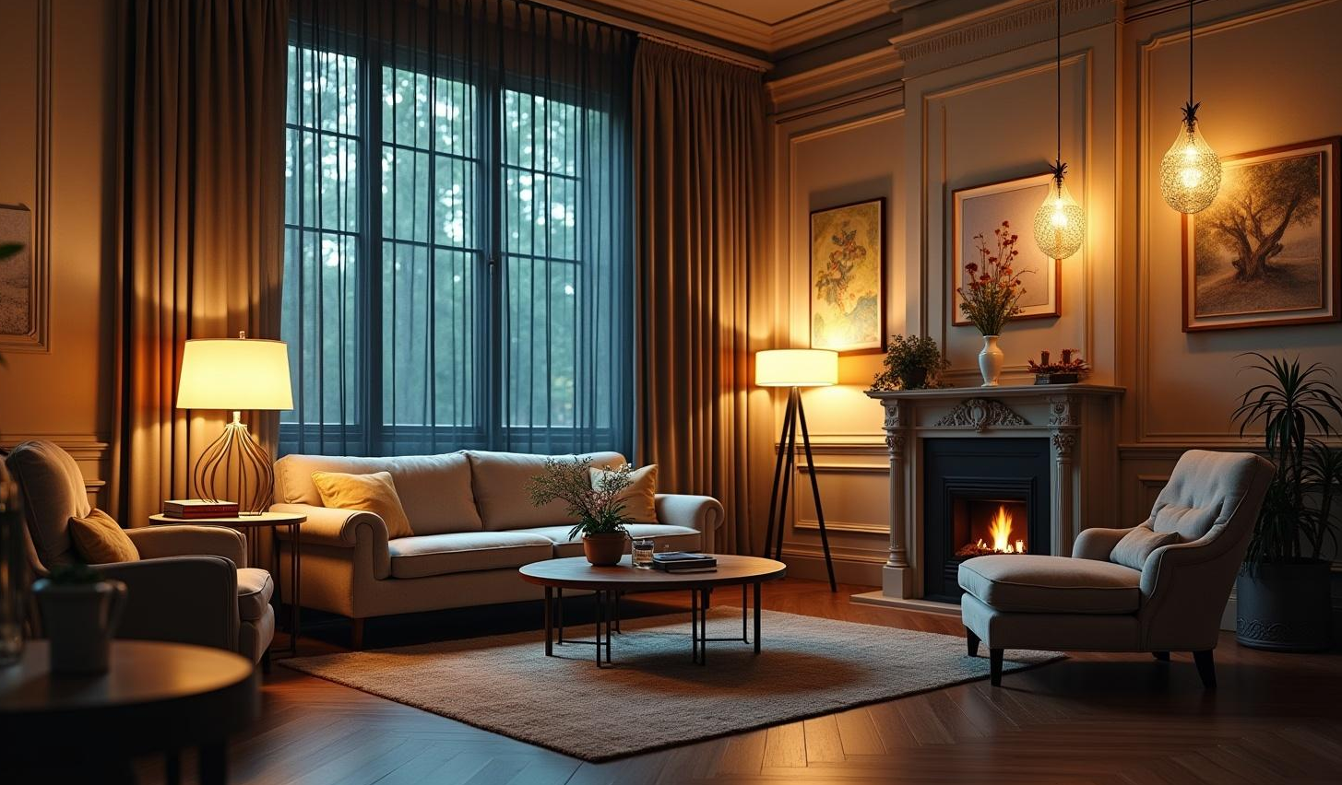
01
Types of Lighting

Slide 4
Natural Lighting
Natural lighting uses sunshine to brighten up spaces. It’s all about having windows, skylights, and open areas that let the light flood in. Not only does it save on energy bills, but it also creates a cheerful and vibrant atmosphere that just feels good!

Slide 5
Artificial Lighting
Artificial lighting comes from sources like bulbs and LEDs that light up our lives, especially in the evenings. Whether you’re using gentle lamps for a cozy mood or bright lights for a productive workspace, the right artificial lighting can make all the difference in how a room feels.

Slide 6

Task Lighting
Task lighting is all about illuminating specific areas where you need it most. Think desk lamps for late-night reading or under-cabinet lights in the kitchen for meal prep. It helps reduce eye strain and makes certain tasks easier to tackle, making your space more functional and enjoyable.

Slide 7
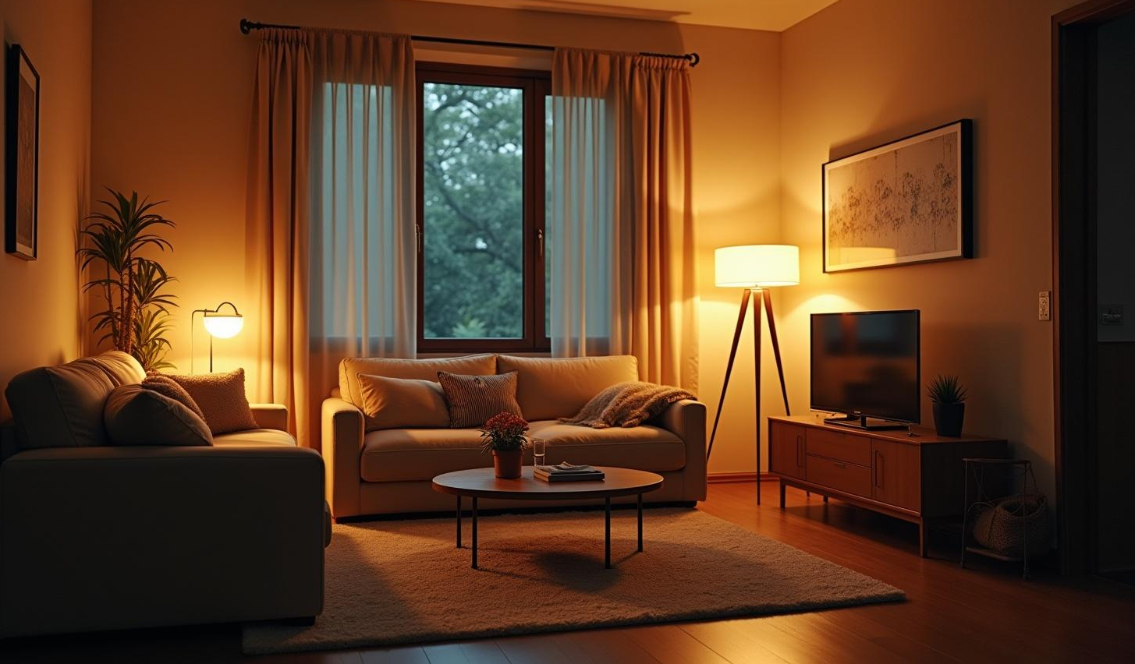
02
Lighting Design Considerations

Slide 8
Energy Efficiency
When it comes to energy efficiency, we want to save some bucks and help the planet too! Using LED lights or smart lighting systems keeps energy use low. Plus, they last longer than traditional bulbs, so it’s a win-win for your wallet and the environment.

Slide 9
Aesthetic Impact
Let’s talk aesthetics! The way lighting is designed can totally transform a space. It sets the mood, highlights beautiful features, and can make a room feel cozy or vibrant. Choosing the right fixtures and light colors can really change the vibe of your home or office!

Slide 10
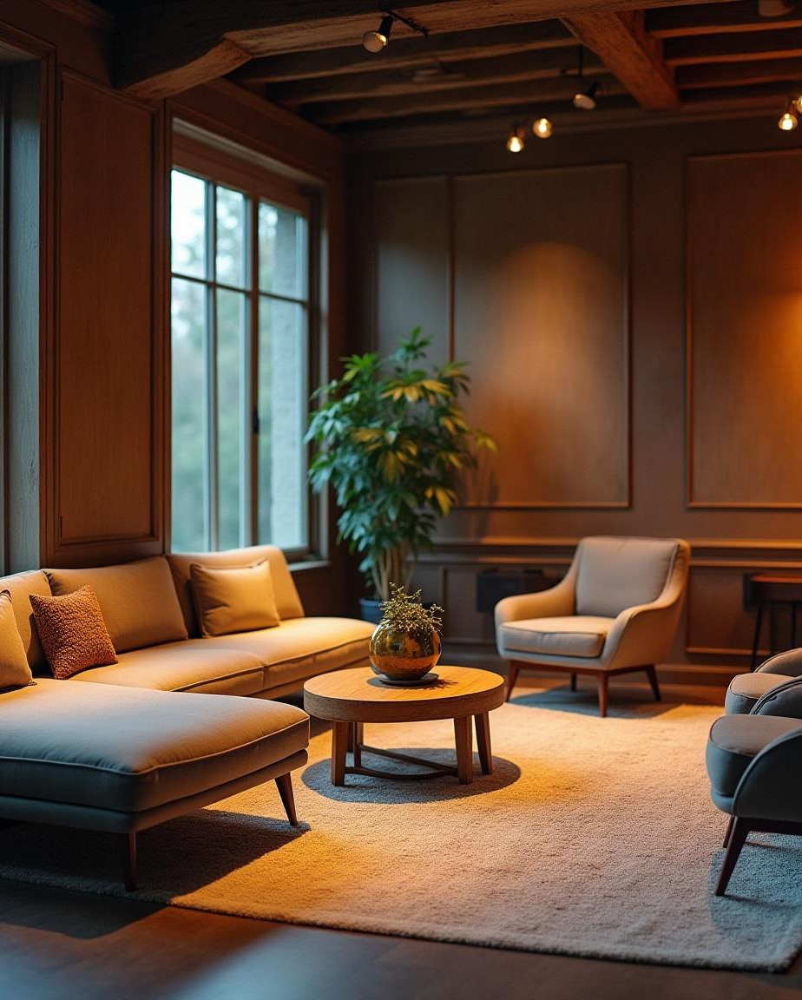
User Comfort
User comfort is key when designing your lighting setup. This means avoiding harsh glare and making sure the brightness levels are just right. When the lighting feels good, it helps everyone feel more relaxed and focused, creating a pleasant space for work or leisure.

Slide 11
Conclusions
In closing, lighting isn’t just about brightness; it’s about creating a welcoming environment! From task lighting to energy-efficient solutions, every little detail matters. So keep comfort and style in mind, and you’ll be well on your way to great lighting!

Slide 12
Thank you!
.
+00 000 000 000

